Slide 1

Project name-
PROJECT TITLE-
Smart Medicine Drawer
SMART MEDICINE DRAWER
Project supervisor- Rishabh raj
Team leader- Deekshant taya
Team members- Loveneet singh slathia
Vandana Chauhan
Vikas sharma

Slide 2

CONTENTS:-
INTRODUCTION
DRAWINGS ON A-4
AUTOCAD DRAWINGS
NOVEL FERATURES
ADVANTAGES
DISVANTAGES
IMPLIMENTATION
ARDUINO UNO
MODULES OF ARDUINO UNO

Slide 3

INTRODUCTION-
Smart Medicine Drawer is an advanced drawer designed for patients to maintain medication . It’s elements are a digital clock, a display, weight sensors, alarm sensor, navigation buttons, enter button, drawer buttons and a power adapter. Whenever the clock strikes the medicine time ,alarm beeps and the particular drawer containing medicines for that time opens up automatically. Also the display on the top shows up the weight of each drawer helping us to know how much of medicine is left. The alarms are set with the help of buttons.

Slide 4
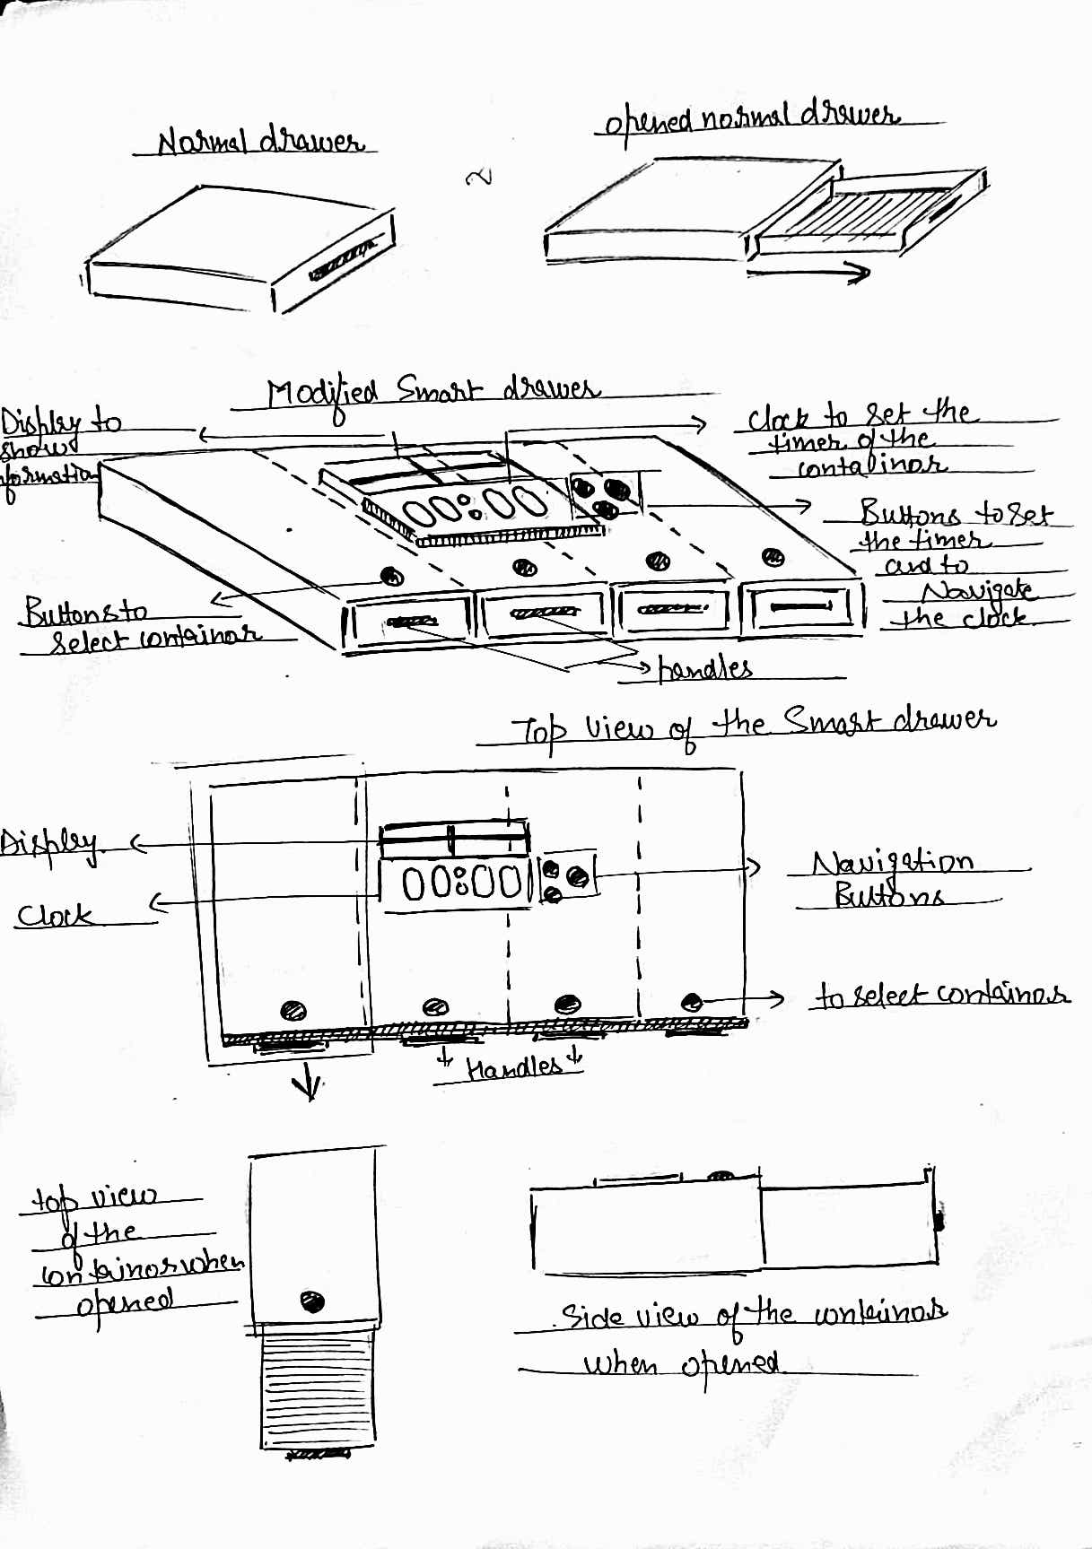
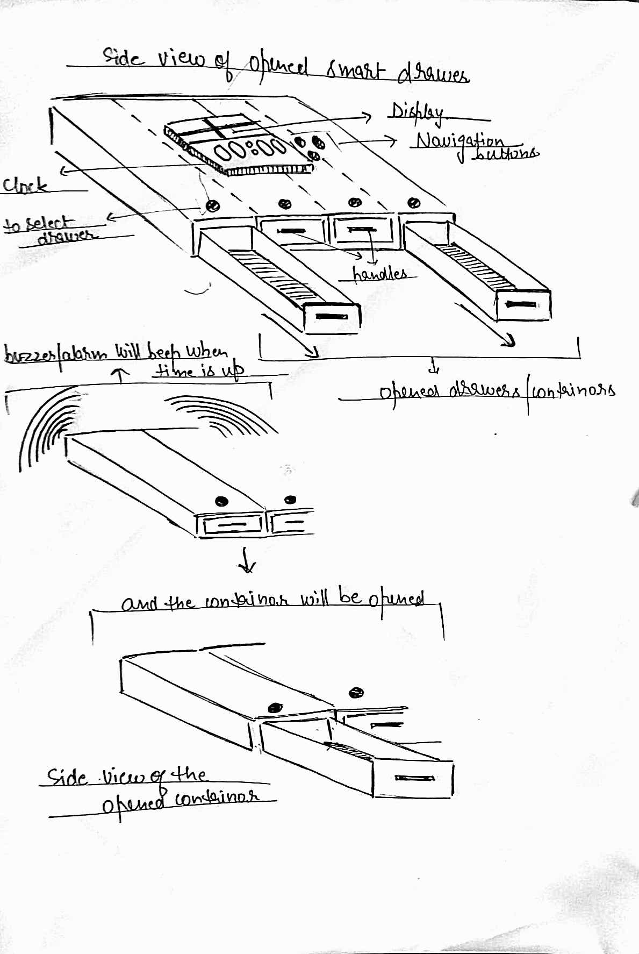
Drawings on a-4 sheet

Slide 5
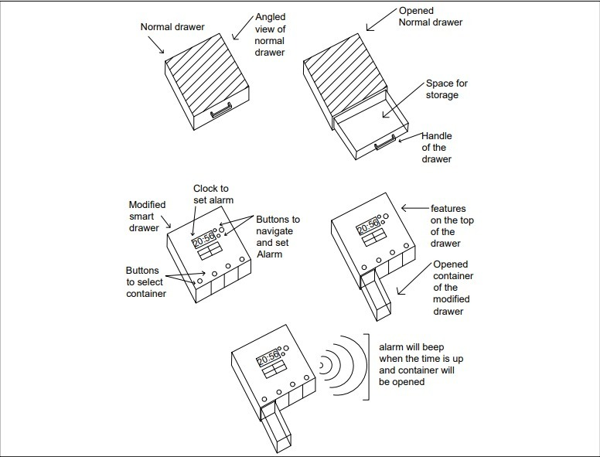
AUTOCAD DRAWING
Open the drawer in which you want to put medicines.
Click on the container button in which you want to set alarm.
Alarm will beep when its time take medicine.
Container having medicine will come out automatically.

Slide 6

novel features
On the top, a clock is mounted.
Every container has a button on it to set the alarm.
It has an automated drawer built inside.
To set the alarm, navigation buttons are mounted.
In the drawer, weighting sensors are installed.
There is an alarm buzzer that will serve as an alert.
Display on the top will show the quantity of medicines left..

Slide 7

advantages
We're never going to forget about taking medication.
Alarm buzzer will give a reminder.
The screen will tell us how much medication is left.
A patient can take medication quickly.
Just the container, which holds the medication we have to take, will come out.

Slide 8

disadvantages
Disadvantage of this device is that it will reduce the work of care takers and nurses which will lead to a decrease in their wages.

Slide 9

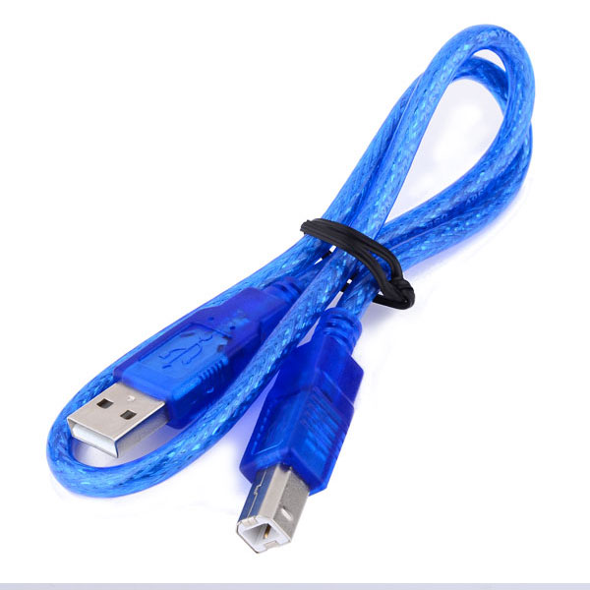
ARDUINO UNO:-
The Arduino Uno is an open source microcontroller board based on the Microchip ATmega328P microcontroller and developed by Arduino.cc. The board is equipped with sets of digital and analog input/output (I/O) pins that may be interfaced to various expansion boards (shields) and other circuits.^{[1]} The board has 14 digital I/O pins (six capable of PWM output), 6 analog I/O pins, and is programmable with the Arduino IDE (Integrated Development Environment), via a type B USB cable.^{[4]} It can be powered by the USB cable or by an external 9-volt battery, though it accepts voltages between 7 and 20 volts. It is similar to the Arduino Nano and Leonardo.

Slide 10
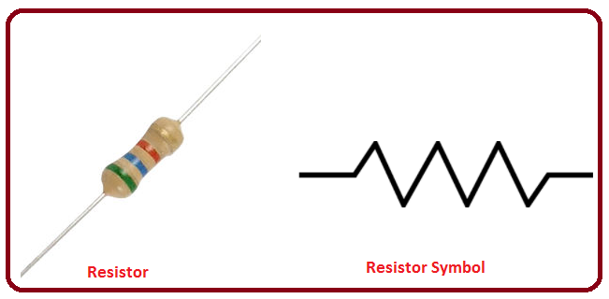
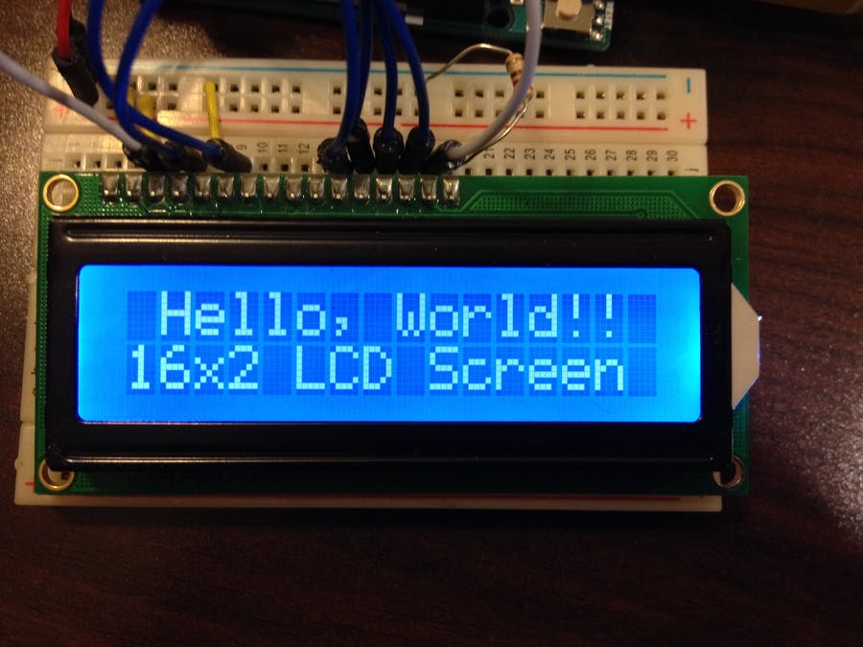
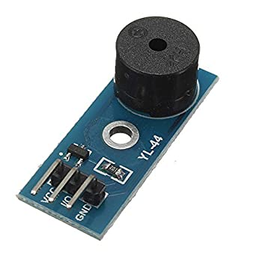
MODULES FOR ARDUINO UNO
RESISTORS 2) LCD DISPLAY 3) BUZZER MODULE
Resistors are used to resist the current according the value of resistors.
LCD display are used to display the output on the screen of LCD.
Buzzer modules are used to beep the sound when needed.

Slide 11
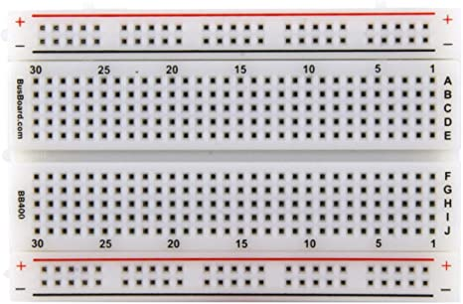
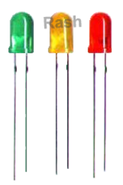
s
4) BREADBOARD 5) LED BULB
BREADBOARD is used to connect wires in a clean manner.
LED bulbs are used to output something.

Slide 12




